Slide 1

Thinking and Intelligence
Chapter 7

Slide 2
Agenda
The Basics of Cognition
Language
Problem Solving
Intelligence
Class Activity

Slide 3
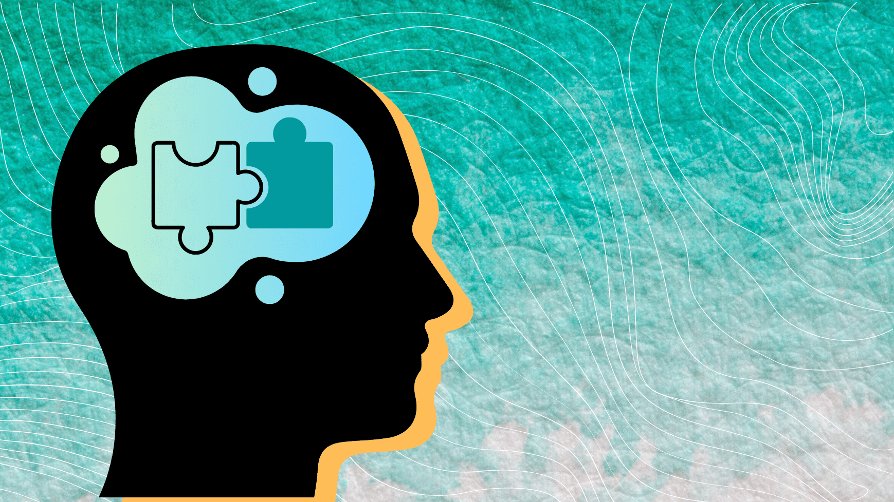
What is cognition?
What all might a cognitive psychologist study?

Slide 4
How do our minds categorize information?
Concepts and prototypes
Natural concepts
Schemas
Role schema
Artificial concepts
Event schema
Object schema
Self-schema

Slide 5

Concepts and Prototypes Example
Let’s walk through concepts and prototypes using a horse as an example.
What are some natural concept?
What are artificial concepts?
What is a horse prototype you have?

Slide 6
Event Schema Example: Horseback Riding
Event Schema: Horseback riding
Concept: What is riding?
Concept: What is a saddle?
Concept: What is a horse?

Slide 7


Slide 8
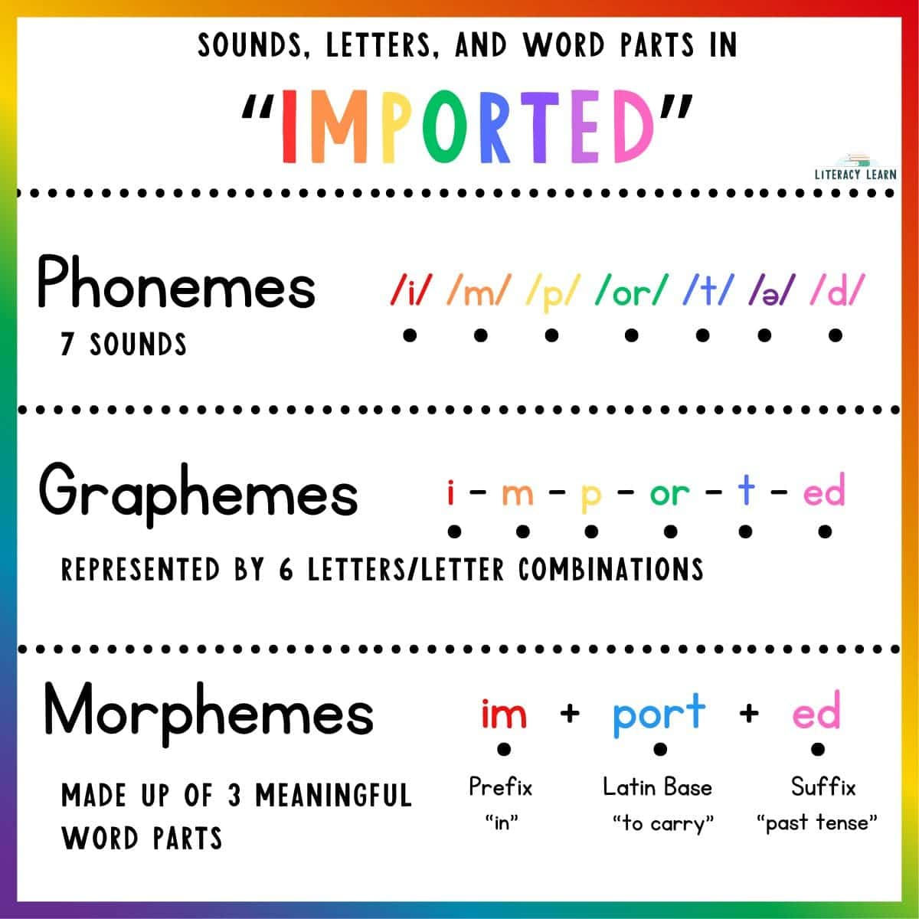
Components of Language
Phoneme
Syntax
Morpheme
Lexicon
Grammar
Semantics
Grapheme

Slide 9
Stages of Language Development
Stage | Age | Developmental Language and Communication
1 | 0–3 months | Reflexive communication
2 | 3–8 months | Reflexive communication; interest in others
3 | 8–13 months | Intentional communication; sociability
4 | 12–18 months | First words
5 | 18–24 months | Simple sentences of two words
6 | 2–3 years | Sentences of three or more words
7 | 3–5 years | Complex sentences; has conversations

Slide 10
Language in Action
What is an example of a child overgeneralizing language?
Has there been a time in your life where you have seen linguistic determinism?

Slide 11
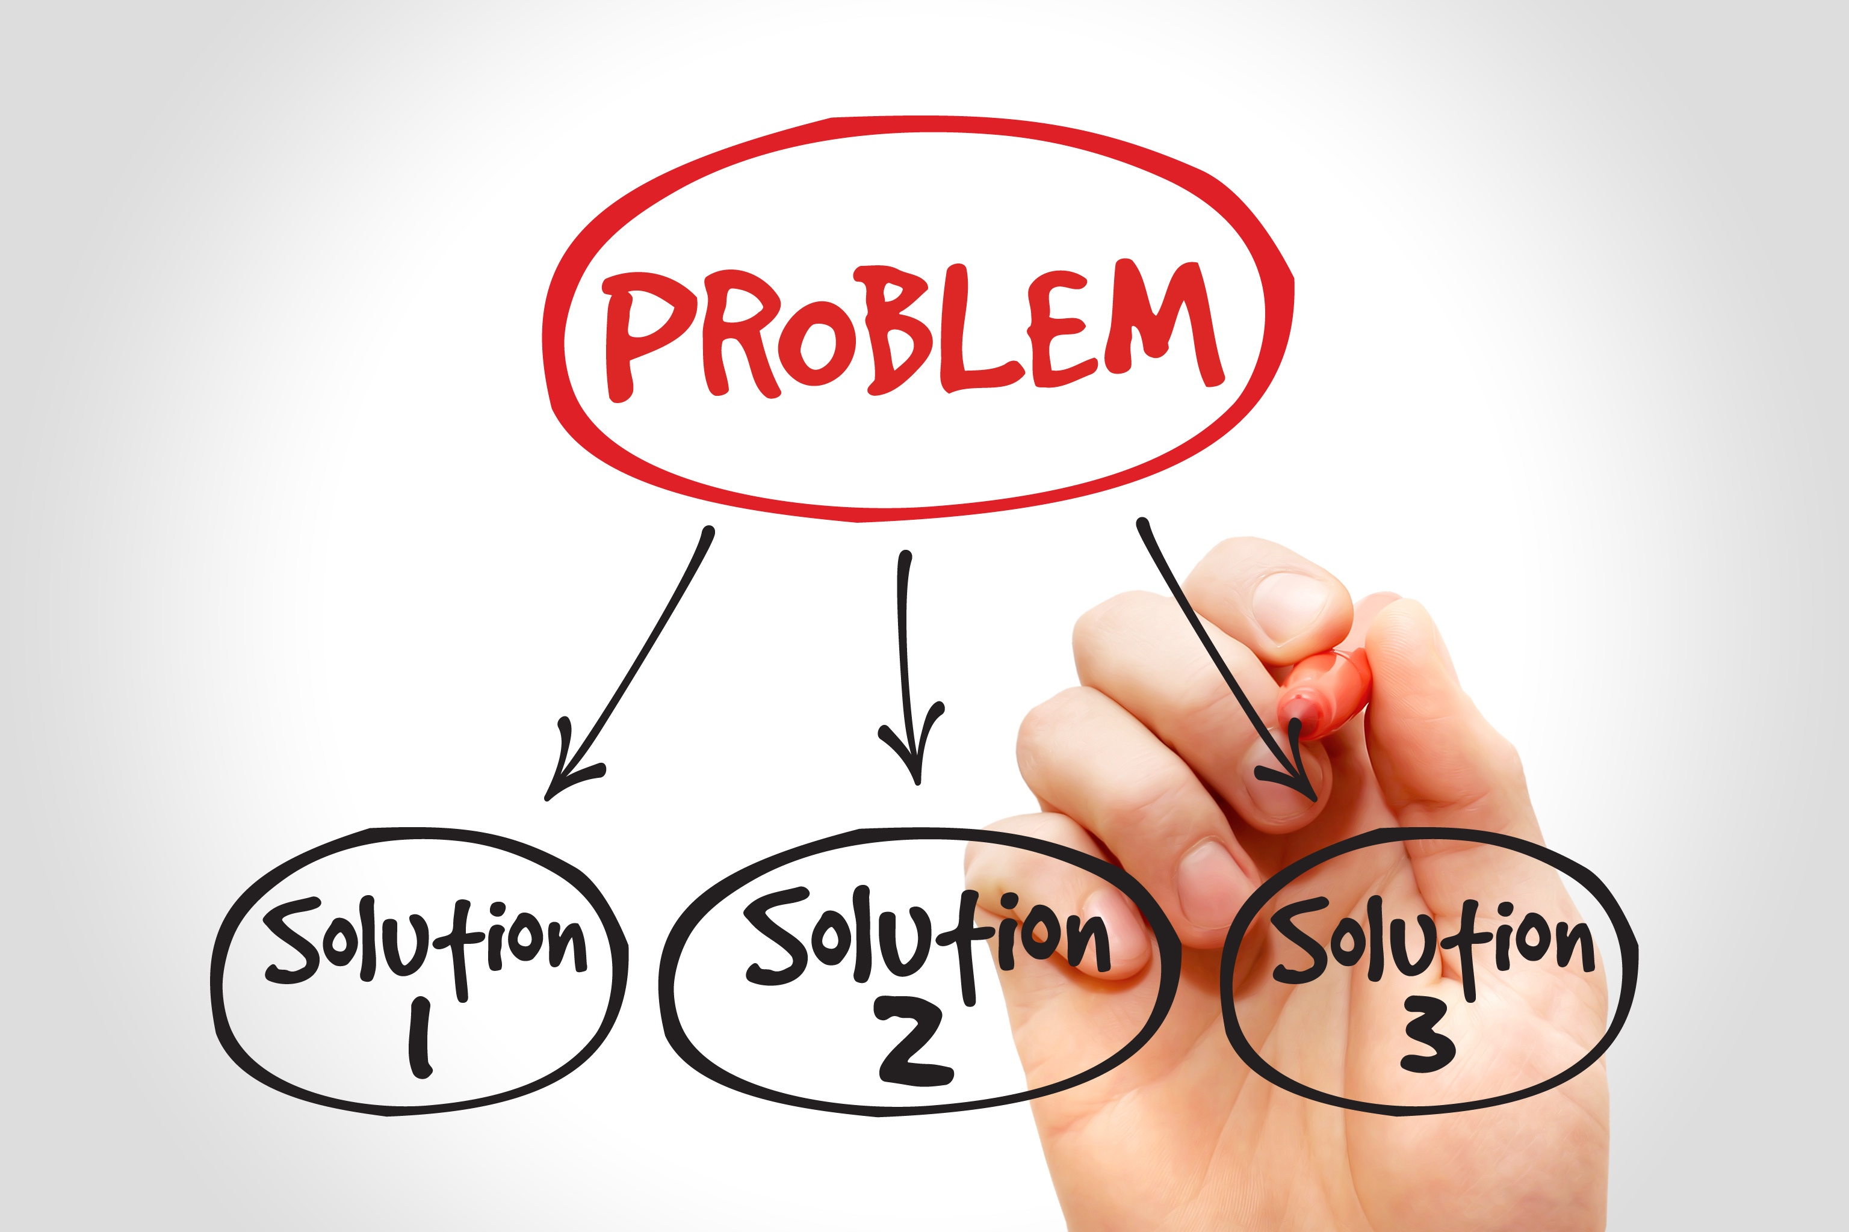
Problem Solving

Slide 12
Problem Solving Strategies
Method | Description | Example
Trial and error | Continue trying different solutions until problem is solved | Restarting phone, turning off WiFi, turning off bluetooth in order to determine why your phone is malfunctioning
Algorithm | Step-by-step problem-solving formula | Instruction manual for installing new software on your computer
Heuristic | General problem-solving framework | Working backwards; breaking a task into steps

Slide 13
Pitfalls in Problem-Solving
Potential Pitfall | Description
Mental set | When someone persists in approaching a problem in a way that has worked in the past but is clearly not working now
Functional fixedness | A type of mental set where you cannot perceive an object being used for something other than what it was designed for
Anchoring bias | Tendency to focus on one particular piece of information when making decisions or problem-solving
Confirmation bias | Focuses on information that confirms existing beliefs
Hindsight bias | Belief that the event just experienced was predictable
Representative bias | Unintentional stereotyping of someone or something
Availability bias | Decision is based upon either an available precedent or an example that may be faulty

Slide 14
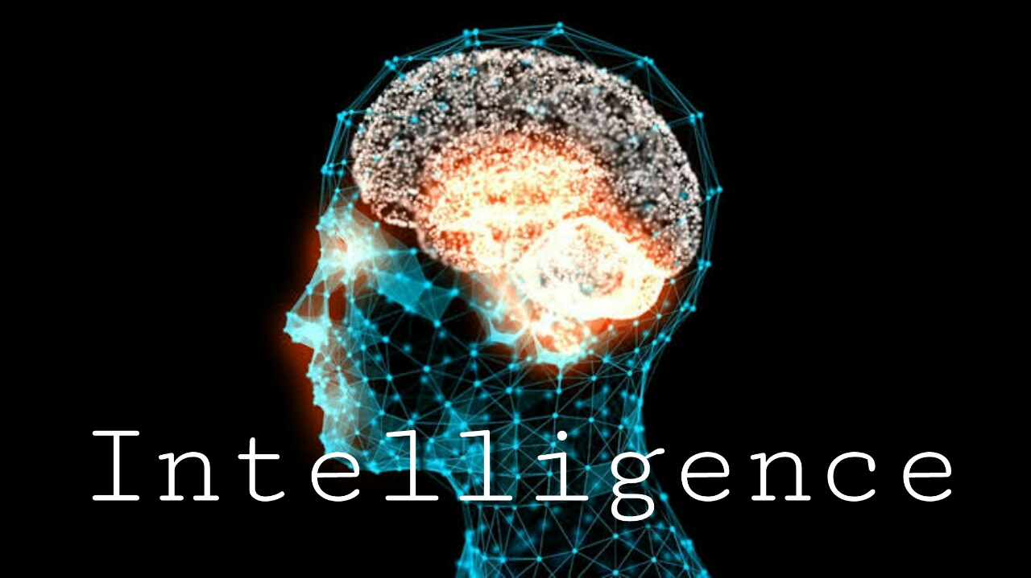
“If the human brain were so simple that we could understand it, we would be so simple that we couldn’t.” ― Emerson M. Pugh

Slide 15
Types of Intelligence: Crystalized vs. Fluid
Crystalized intelligence
Fluid intelligence
Acquired knowledge you can retrieve
Ex: Answering Biology quiz questions after studying the textbook
Ability to see complex relationships and solve problems
Ex: Finding your way home when a road is closed

Slide 16
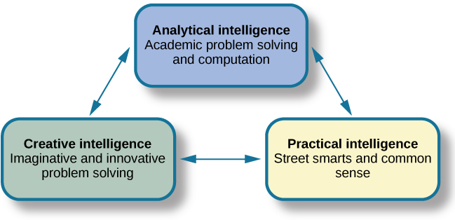
Triarchic Theory of Intelligence

Slide 17
Multiple Intelligences Theory
Proposed by Howard Gardner
Each person possesses at least eight intelligences:
linguistic intelligence
logical-mathematical intelligence
musical intelligence
bodily kinesthetic intelligence
spatial intelligence
interpersonal intelligence
intrapersonal intelligence
naturalistic intelligence
Heavily criticized for lack of empirical evidence

Slide 18
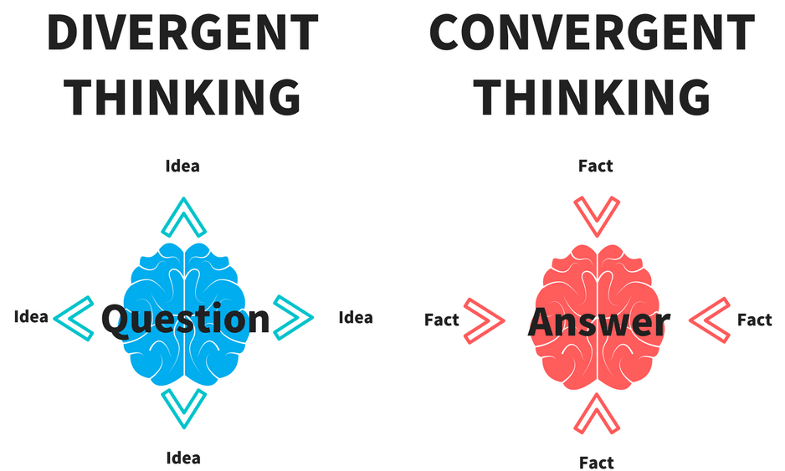
Creativity

Slide 19
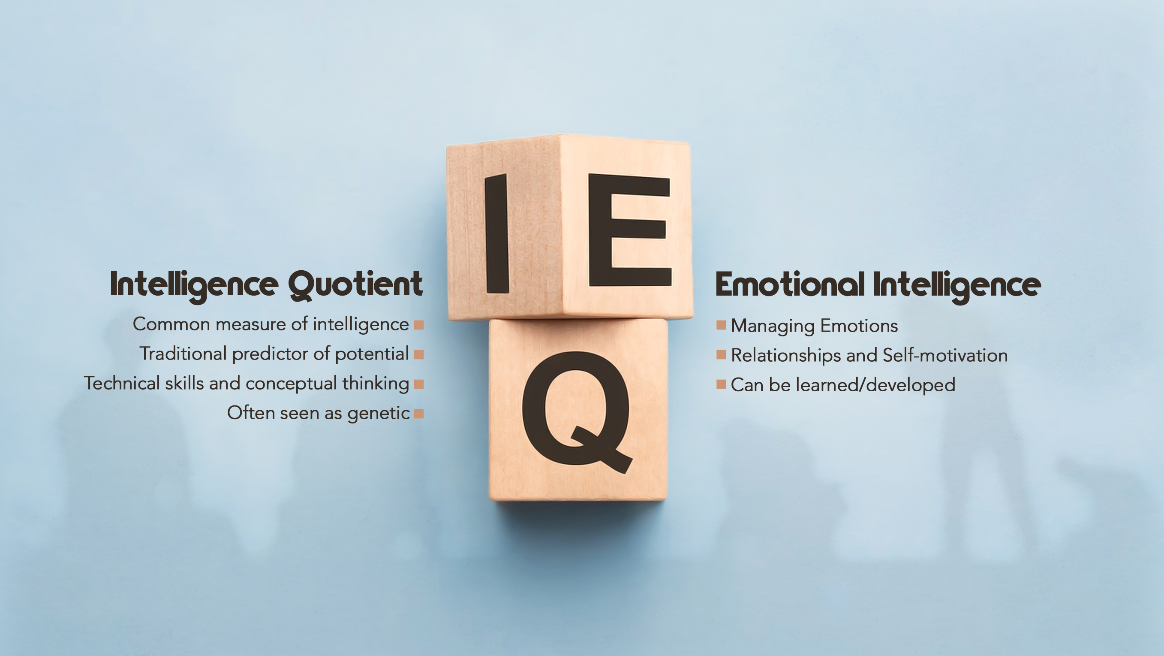
Emotional Intelligence
“EQ”
the ability to understand the emotions of yourself and others, show empathy, understand social relationships and cues, and regulate your own emotions and respond in culturally appropriate ways

Slide 20
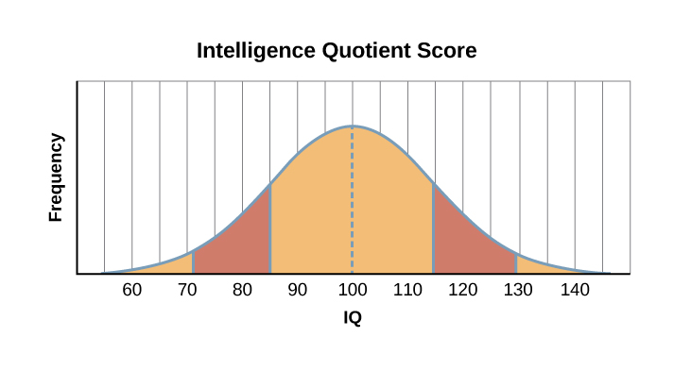
Measuring Intelligence
Intelligence quotient (IQ)
The Wechsler-Belllevue Intelligence Scale(s)
Later version: Wechsler Adult Intelligence Scale (WAIS)
Standardization
Norming
The Flynn effect

Slide 21
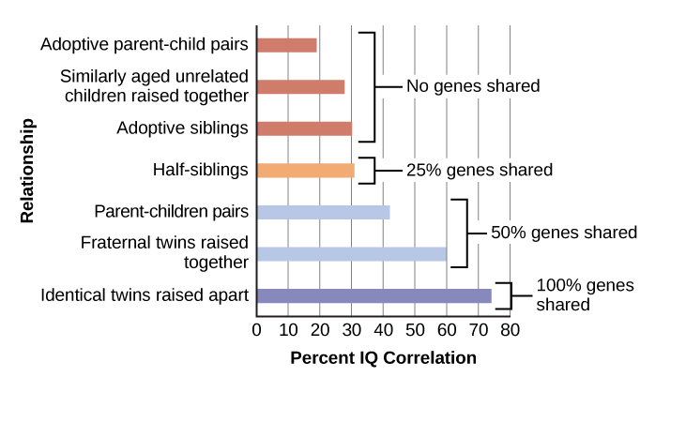
Intelligence: Nature vs Nurture
But, don’t forget… Range of Reaction!

Slide 22
Learning Disabilities
Myth
Fact
1: “Learning disability” is a blanket term for any difficulty struggling with learning
2: People with learning disabilities are less intelligent
3: More people are being diagnosed with learning disabilities than ever before
1: A learning disability refers a series of disorders where information is not being stored/ retrieved/ or processed correctly
2: People with learning disabilities have brains that work in different ways
3: We have greatly improved in our ability to accurately diagnose learning disabilities

Slide 23
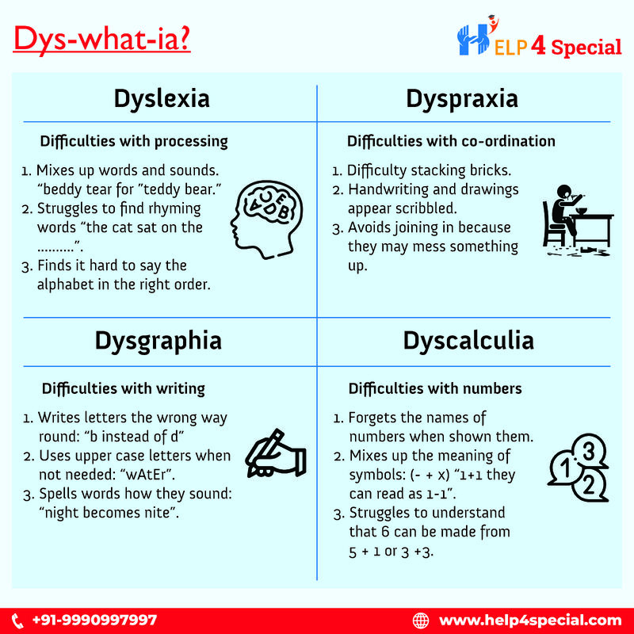
Common Learning Disabilities

Slide 24
Next Time on PSY 203…
Before Next Class:
Next Class:
Sign up for research
First deadline is March 5th
Review material
Next exam is Tuesday!!
Exam 2

